Slide 1
Environmental Planning Sub Committee
Adam Hoyles, Committee Vice Chair
08/27/20

Slide 2
Agenda
Welcome, Opening and Roll Call – Vice Chair Hoyles 4:00-4:05pm
Review of Agenda– Vice Chair Hoyles 4:05-4:10pm
COJ ‘Trees to Offset Stormwater Study’, Recommendations and Stormwater Uptake Calculator
Karen Firehock, Executive Director - Green Infrastructure Center 4:10-4:30pm
Q&A 4:30-4:40pm
Working Group Breakout Session 4:40-5:15pm
Working Group Report Out 5:15-5:30pm
Close 5:30pm

Slide 3
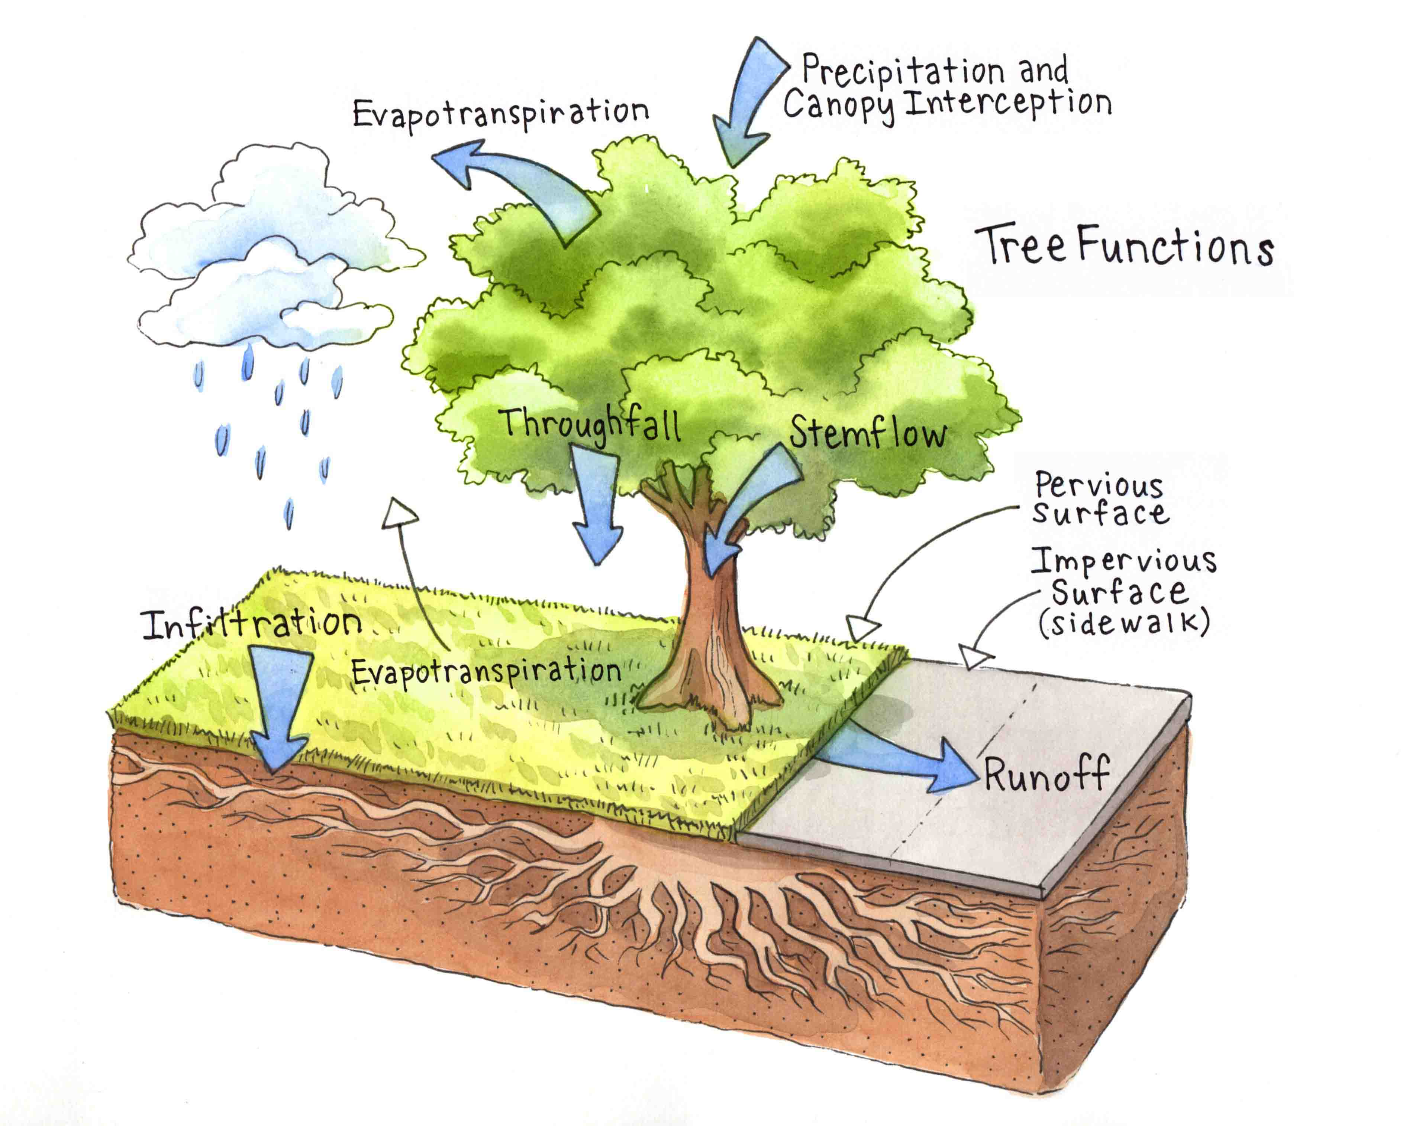
Green Infrastructure Center
Karen Firehock, GIC Executive Director and Co-Founder
Prepared Trees to Offset Stormwater Case Study 12, City of Jacksonville, FL May 2019
Project Overview - The Trees to Offset Stormwater project is a study of the role of Jacksonville’s tree canopy in taking up, storing and releasing water. This study was undertaken to assist Jacksonville in evaluating how to better integrate trees into their stormwater management programs. More specifically, the study covers the role that trees play in stormwater management and shows how the city can benefit from tree conservation and replanting. It also evaluates ways for the city to improve forest management as the city develops.

Slide 4
Environmental Planning Structure
Land Use Planning
Environmental Justice
Hazard 1: Sea/River Level Rise – Coastal Surge, Extreme Tides | Hazard 2: Extreme Precipitation Events and Rain Pattern | Hazard 3: Mean Temperature Increase and Heat Waves
Coastal, River and Tributary Shoreline Impact | Shoreline Impact | Contribution to Ocean and River’s Surface Temperature Rise
Economic, Health, Social and Safety Impact of Flooding | Functionality of Stormwater Mgt Systems and Wetlands | Impact on Health and Well-being of Residents
Saltwater Intrusion | Economic, Health, Social and Safety Impact of Flooded Streets, Homes and Businesses | Contribution to Droughts and Wildfires
Riverine (St Johns, Tributaries and Wetlands) Health, Depth and Resilience | Run Off Contribution to Poor Water Quality in River and Its Tributaries | Impact on Vegetation and Agriculture

Slide 5
Assignments *Working Group Co-Leaders
Land Use Planning – Bill Bishop, Mark Middlebrook, Josh Rosenberg and Kevin O’Halloran
Environmental Justice – Ashantae Green, Todd Sack and Patrick Krechowski
Hazard 1: Sea/River Level Rise – Coastal Surge, Extreme Tides | Hazard 2: Climate Change - Extreme Precipitation Events and Rain Pattern | Hazard 2: Climate Change - Mean Temperature Increase and Heat Waves
Steve Swann* | Adam Hoyles* | Adam Bosenblatt*
Dr. Quinton White | Bruce Fouraker | Ashantae Green
Joshua Rosenberg | Patrick Krechowski | J. Logan Cross
Shannon Blankinship* | James Richardson | Sarah Boren*
Mark Middlebrook | Kevin O’Halloran | Bill Bishop
Todd Sack | Guillermo Simon*

Slide 6
Hazard 1 Working Group Breakout - Near Term Policy Recommendations
Hazard 1 Working Group Assignment –
Develop a list of adverse consequences of sea/river level rise, coastal surge and extreme tides that are within our control or may be reversed
Examples might be –
Diminishing wetlands that serve to accept, retain and filter high water from extreme events
Tributaries which may be silted in or rechannelled, consequently have reduced capacity to serve as a buffer for flood waters
Softened shorelines which could provide a more absorbent interface compared to a hardened shoreline
Waterfront building set back policies where there is or will be flooding
Other….
Vital few policy recommendations to address
Assignments outside formal meeting
Report on progress

Slide 7
Hazard 2 Working Group Breakout - Near Term Policy Recommendations
Hazard 2 Working Group Assignment – Focus on saving existing tree canopy to continue to take up stormwater and reduce heat
Consider Recommendations from ‘Trees to Offset Stormwater Study’ to Mitigate Hazards
Review current tree mitigation ordinance
Does the current policy need to be strengthened to protect existing tree canopy?
Public property
Private property
Under served areas in Duval Co.
Use of stormwater uptake calculator to assess the impact of taking trees down and consider using to assess tree removal penalty
Turning appropriate ‘Trees to Offset Stormwater Study’ recommendations into policy recommendations
Additional recommendations
Collaborate with Hazard 3 Working Group on adding to tree canopy
Assignments outside of formal meeting
Report on progress

Slide 8
Hazard 3 Working Group Breakout - Near Term Policy Recommendations
Hazard 3 Working Group Assignment – Focus on intentional addition to the county’s tree canopy to enhance storm water uptake and reduce heat
Consider Recommendations from ‘Trees to Offset Stormwater Study’ to Mitigate Hazards
Review current tree mitigation ordinance
Does the current policy need to be strengthened to add trees where they have the most impact?
Public property
Private property
Under served areas in Duval Co.
Use of stormwater uptake calculator to assess the impact of adding trees to certain high impact areas?
Turning appropriate ‘Trees to Offset Stormwater Study’ recommendations into policy recommendations
Additional recommendations
Collaborate with Hazard 2 Working Group on adding to tree canopy
Assignments outside of formal meeting
Report on progress

Slide 9
Working group report out

Slide 10
Close
Next Sub Committee Meeting
09/10/20, 4pm

